Slide 1
Be drug
free.
Be happy.
Be brave.
Red Ribbon Week
October 26-30, 2020

Slide 2
What is Red Ribbon Week?
Red Ribbon Week is a national campaign that began almost 30 years ago.
National means it is recognized all around the United States of America.
A campaign is like a project or a way to get others to hear your message.
The Red Ribbon campaign started as a way for schools and communities to stand up against drugs and the harm they were causing in our country.
We want our students, families, and community to be healthy and safe.

Slide 3
Like hundreds of schools across America, Woodland comes together each October to talk about making healthy choices and living a drug-free life.
Healthy choices include:
saying no to drugs and tobacco
being a good citizen
getting exercise
making smart choices in friends, food, and hygiene
doing your personal best in school

Slide 4
Healthy Choices
Pop Quiz

Slide 5
An elementary school-aged child needs _____ hours of sleep per night.
7 to 8 hours
12 or more hours
10 to 11 hours

Slide 6
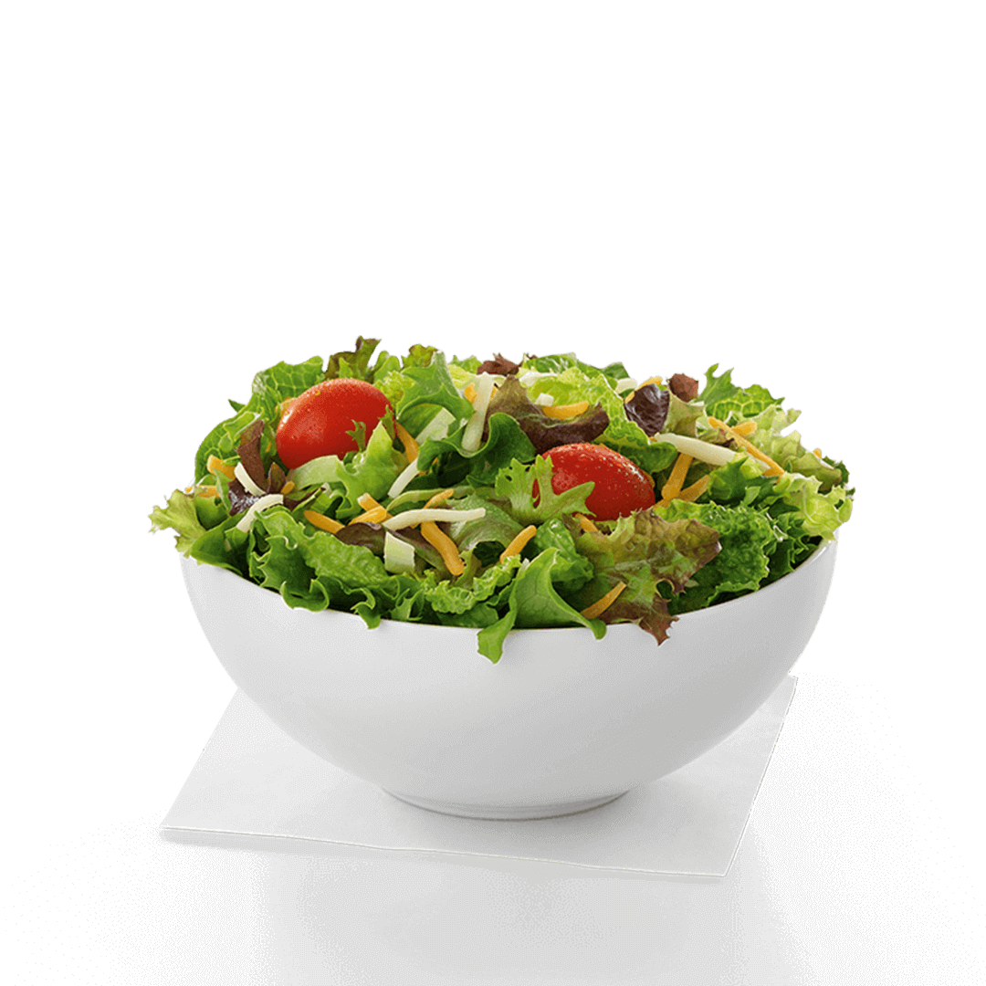
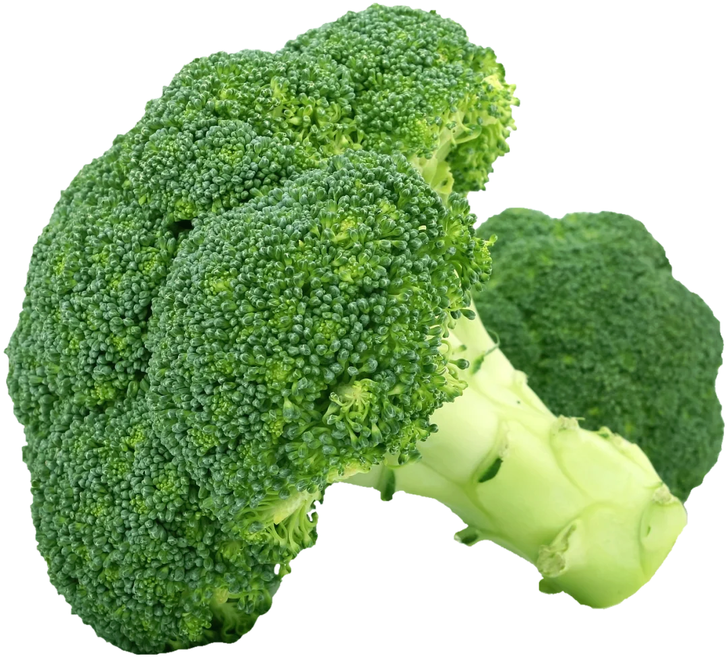
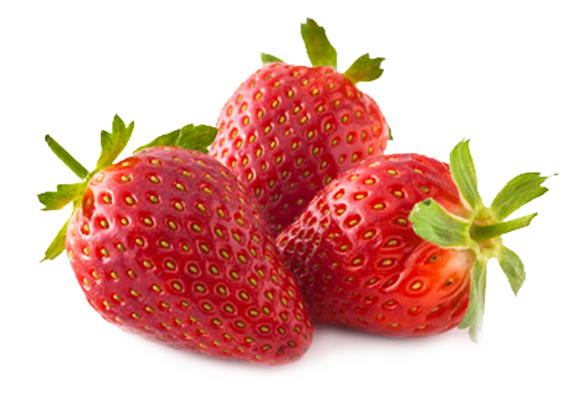
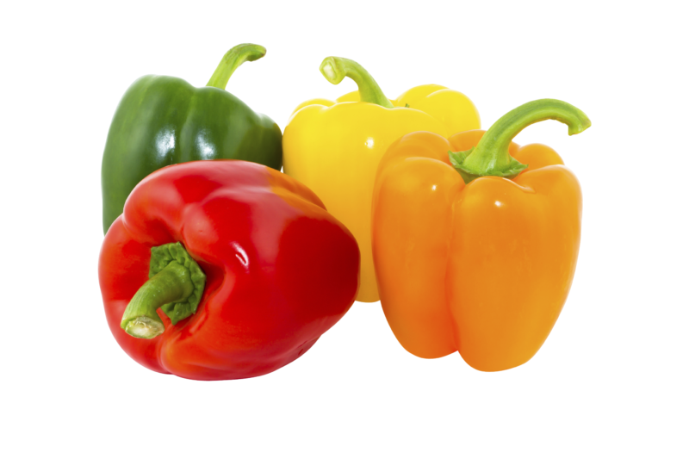
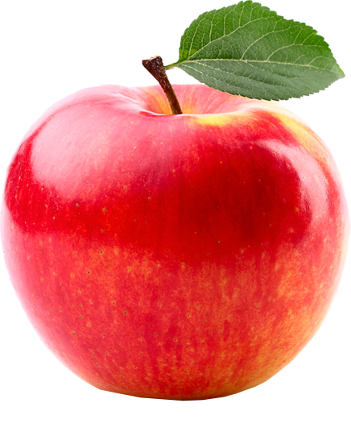
2. How many servings of fruits AND vegetables does a school-aged child need
per day?
8
2
5

Slide 7
3. To stay healthy, an average child needs _______ hours of exercise a day?
4 hours
0 hours
1 hour

Slide 8
4. What is the best way to stay safe in a car?
Wear your seatbelt
Don’t text or talk on the phone
Drive the speed limit
All of the above

Slide 9
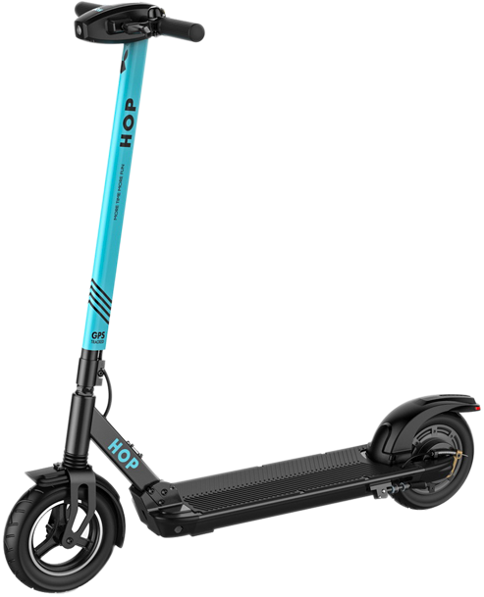
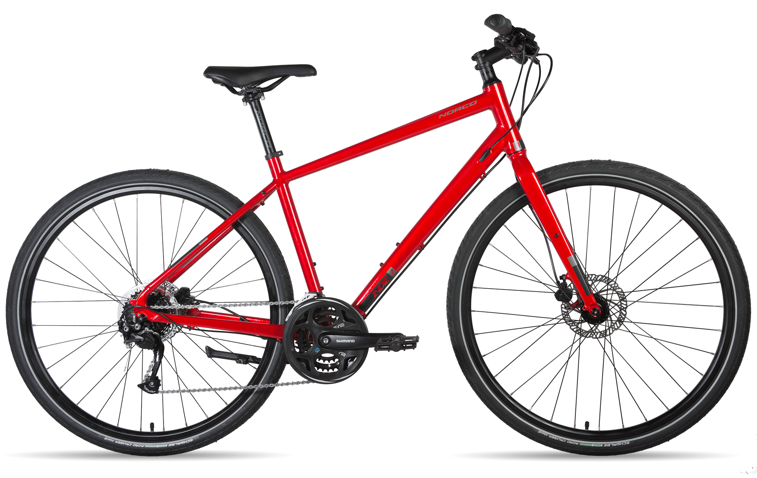
5. What is the best thing you can do to keep your brain safe when you skate,
scooter or ride a bike?
Listen to music
Put on a Royals baseball cap
Wear a helmet

Slide 10
Be happy. Be Brave. Be Drug Free.
Spirit
Week
Monday, 10/26 - Team SPE for Wellness
Wear athletic pants and your favorite team shirt!
Tuesday, 10/27 - We are “REDy” to make healthy choices
Wear RED!
Wednesday, 10/28 - Healthy Panthers are Happy Panthers
Wear a SPE shirt and school colors!
Thursday, 10/29 - Kindness Counts
Wear a shirt with a positive message or a bright color!
Friday, 10/30 - Hats Off to Happiness
Wear a hat that makes you happy!

